Slide 1

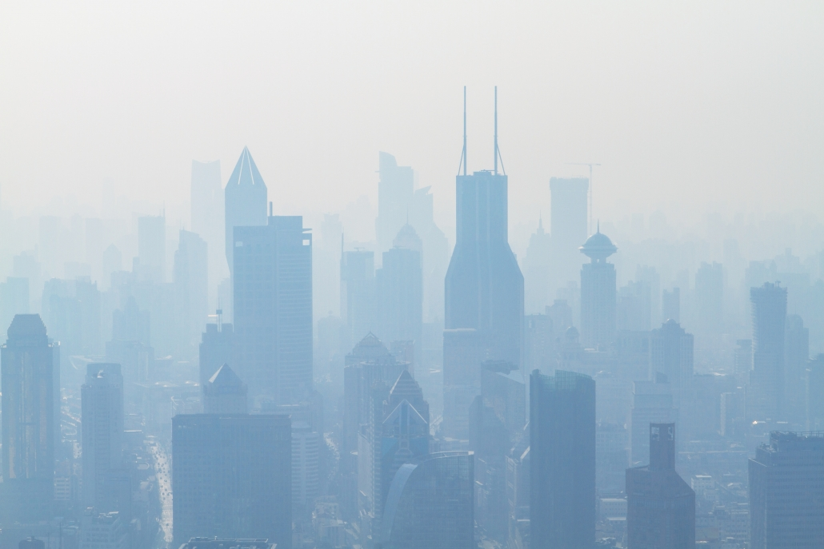
A comparative study of neural network models in air quality prediction
21BCE1796 - B SHAKTHI
21BCE1873 - V GAGANDEEP
21BCE1992 - V SARANYA SARATHY
Guide : Dr. Mercy Rajaselvi Beaulah

Slide 2
Guide
Approval

Slide 3
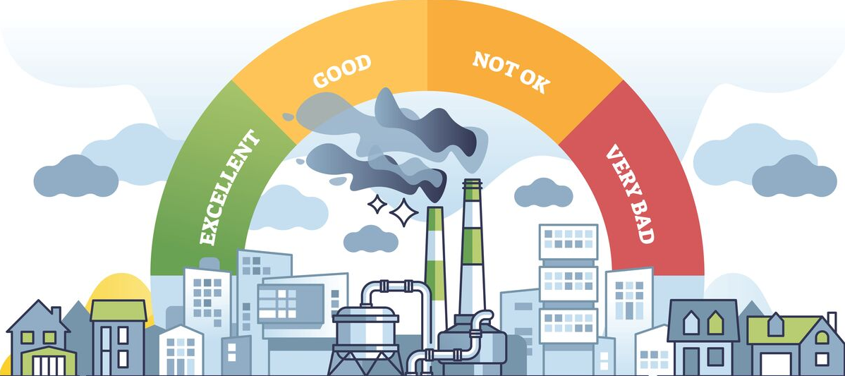
Introduction
An Overview of Air Quality Monitoring and Advanced Forecasting Techniques

Slide 4
Introduction
An Overview of Air Quality Monitoring and Advanced Forecasting Techniques
Air quality is a critical determinant of public health and environmental well-being. With rapid urbanization and industrialization, monitoring and predicting air quality metrics such as Carbon Monoxide (CO), Nitric Oxide (NO), Particulate Matter (PM2.5, PM10), and other pollutants has become increasingly important.
Accurate forecasting of these metrics can aid in proactive decision-making and policy implementation to mitigate air pollution. Machine learning (ML) models have emerged as powerful tools for analyzing time series data and predicting environmental parameters.
Concurrently, advancements in sensor technology enable real-time data collection, enhancing the accuracy and granularity of air quality assessments.

Slide 5
Problem Statement
Optimizing Air Quality Prediction Through Real-Time Data Collection and Advanced Neural Network Architectures
The rise in air pollution levels has led to severe health risks, economic losses, and environmental challenges. Traditional methods of air quality monitoring are often reactive and lack predictive capabilities.
Additionally, there is a growing need to integrate real-time data collection with robust predictive models to enable accurate forecasting of air quality metrics for effective environmental management.
Identifying the most suitable machine learning model for time series prediction and implementing a practical hardware solution for real-time monitoring remain significant challenges.

Slide 6

Project
Objectives
Building an Air Quality Monitor and Evaluating Neural Networks for Accurate Forecasting

Slide 7
Project Objectives
Building an Air Quality Monitor and Evaluating Neural Networks for Accurate Forecasting
The primary objective of this research is to conduct a comparative analysis of three machine learning models—Liquid Neural Networks (LNN), Long Short-Term Memory (LSTM), and Gated Recurrent Units (GRU)—to predict air quality metrics such as CO, NO, PM2.5, and PM10 over a 30-day forecast period.
This study aims to develop a hardware system that collects real-time air quality data using sensors, computes the Air Quality Index (AQI) using a mathematical formula, and stores the recorded values in a database for further analysis.
By bridging predictive modeling with hardware based measurement reading, this research aspires to provide a comprehensive solution for air quality management.

Slide 8

Methodology

Slide 9
Methodology
The proposed system integrates a dual-faceted approach to address air quality monitoring and prediction. First, it employs machine learning models to analyze time series data and generate accurate predictions of air quality metrics.
The comparative study evaluates the performance of LNN, LSTM, and GRU based on metrics like accuracy, computational efficiency, and scalability. Second, the system incorporates a hardware model equipped with sensors to measure pollutants such as CO, NO, PM2.5, and PM10 in real-time.
The hardware component calculates AQI using standard mathematical formulas and securely stores the data in a database for visualization and further processing. This hybrid system ensures both forward-looking predictive insights and real-time monitoring capabilities.

Slide 10

System architecture
Design and Workflow of the Integrated Monitoring and Forecasting System

Slide 11
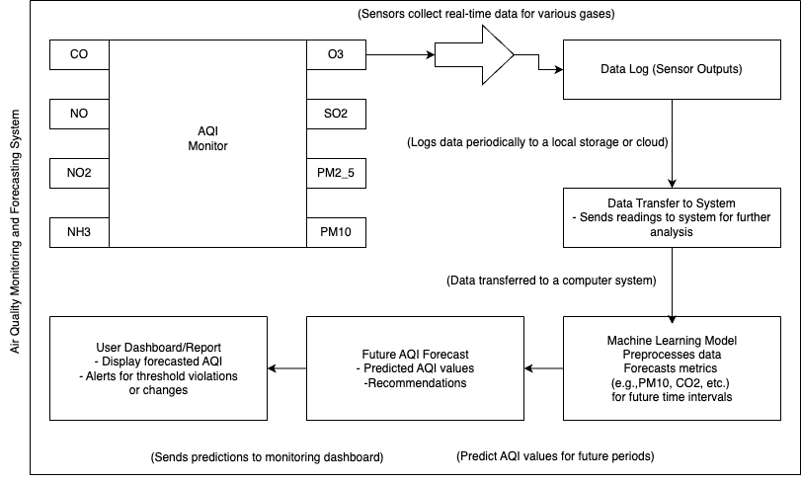

Slide 12

Dataset details
Dataset Overview: delhi_aqi.csv - Hourly Air Quality Data for Delhi (Nov 2020 - Feb 2021)

Slide 13
Dataset Name: delhi_aqi.csv
Contains hourly air quality index (AQI) data for Delhi, India.
Covers data from November 25, 2020, to February 23, 2021.
Format: CSV (Comma-Separated Values).
Includes the following columns:
date: Timestamp of the measurement (DD-MM-YYYY HH:MM).
co: Carbon monoxide levels (µg/m³).
no: Nitric oxide levels (µg/m³).
no2: Nitrogen dioxide levels (µg/m³).
o3: Ozone levels (µg/m³).
so2: Sulfur dioxide levels (µg/m³).
pm2_5: Particulate matter (PM2.5) levels (µg/m³).
pm10: Particulate matter (PM10) levels (µg/m³).
nh3: Ammonia levels (µg/m³).
Hourly data enables detailed trend analysis of air quality over time and is Focused on Delhi, which faces significant air quality challenges.
Useful for environmental research, public health studies, and policymaking and Can be used to analyze pollutant trends, correlations, and regulation effectiveness.
Helps visualize pollution levels over time for better communication.

Slide 14

Module 1
Data Preprocessing and Exploratory Data Analysis (EDA)

Slide 15
Module - 1
In this module, we focus on data preprocessing and Exploratory Data Analysis (EDA), which are essential steps before training any machine learning or deep learning model. Proper preprocessing ensures that the data is in an appropriate form for the model, while EDA helps us understand the dataset, identify patterns, and handle any inconsistencies.
The first step is to load the dataset that will be used for predictive modeling. For this task, we use a dataset containing Air Quality Index (AQI) values for various pollutants over time in a particular city (e.g., Delhi).
Data Source: The data is usually stored in a CSV file, and we use pandas to load it into a DataFrame.
Before jumping into data preprocessing, it's essential to perform an Exploratory Data Analysis (EDA) to get a sense of the dataset's characteristics, such as the distribution of values, missing data, outliers, etc.
Check Column Names: Verify the column names to ensure no inconsistencies or unwanted characters are present.
Check for Missing Values: Identify if there are any missing values in the dataset, which will need to be handled.

Slide 16
df.info() Output
What it shows:
Basic metadata about the DataFrame, including:
Total rows (18776 in this case).
Number of non-null values in each column.
Data types of each column (e.g., float64, object).
Memory usage.
Key takeaways:
There are no missing values since all columns have 18776 non-null entries.
The date column is stored as an object but should be converted to datetime for time-series analysis.
The rest of the columns are numerical, making them suitable for statistical and visual analysis.
Explanation:
Class Information: The dataset is stored as a pandas DataFrame.
RangeIndex: The dataset contains 18,776 rows, numbered from 0 to 18,775.
Column Summary:
There are 9 columns, including the date column and 8 numerical pollutant readings.
The date column is of type object and should be converted to datetime for better handling of time-series data.
All numerical columns (co, no, no2, etc.) are float64, suitable for statistical computations.
Non-null Counts: No missing values are present in any column, which is ideal for analysis.
Memory Usage: The dataset uses approximately 1.3 MB of memory

Slide 17
Module - 1
Duplicate Rows Check:
The output confirms that there are no duplicate rows in the dataset. This means each row in the dataset represents unique data points for the hourly air quality measurements.
Significance:
The absence of duplicates ensures that the data is clean and accurate for further analysis. Duplicate rows in datasets like this could skew statistical measures or lead to misleading trends, so it's crucial to confirm there are none.
If Duplicates Were Found:
For datasets involving time-series data like hourly air quality, duplicates might sometimes occur due to errors in data recording. In such cases, duplicates can be removed using df.drop_duplicates().
If duplicates represent valid readings (e.g., two identical readings recorded within the same hour), they might need further domain-specific analysis to decide whether to retain or drop them.

Slide 18
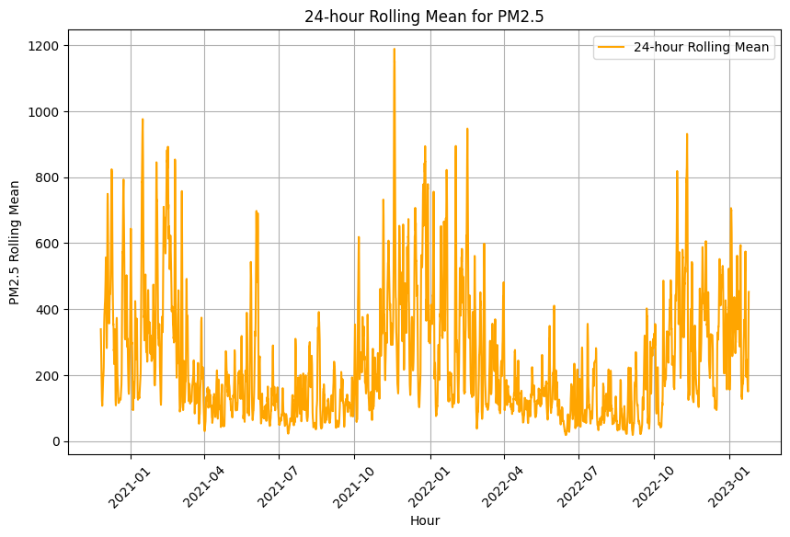
Module - 1 : Exploratory data analysis
Rolling Mean Plot for Trend Smoothing
To study long-term trends, you can smooth out the data using a rolling mean (moving average).

Slide 19
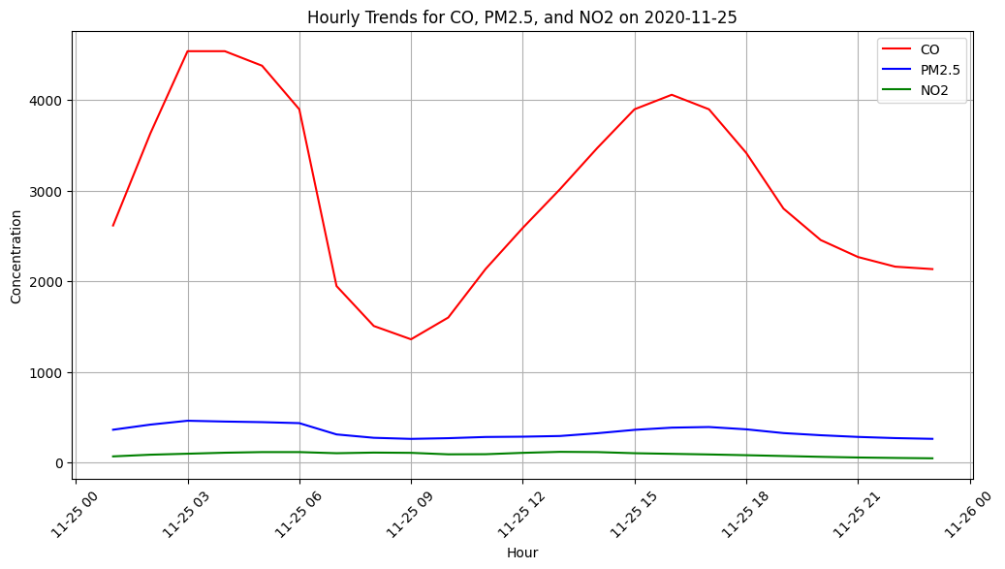
Module - 1 : Exploratory data analysis
Trend Plot for Multiple Parameters (e.g., co, pm2_5, no2) Over a Day
Multiple Parameters: This plot compares the hourly trends of co, pm2_5, and no2 for a given day, helping to understand their patterns over time.

Slide 20
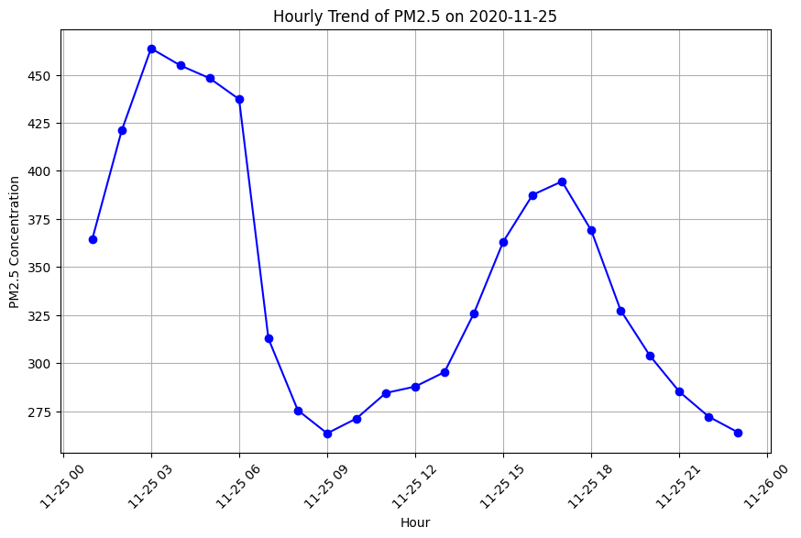
Line plot : PM2.5 distribution

Slide 21
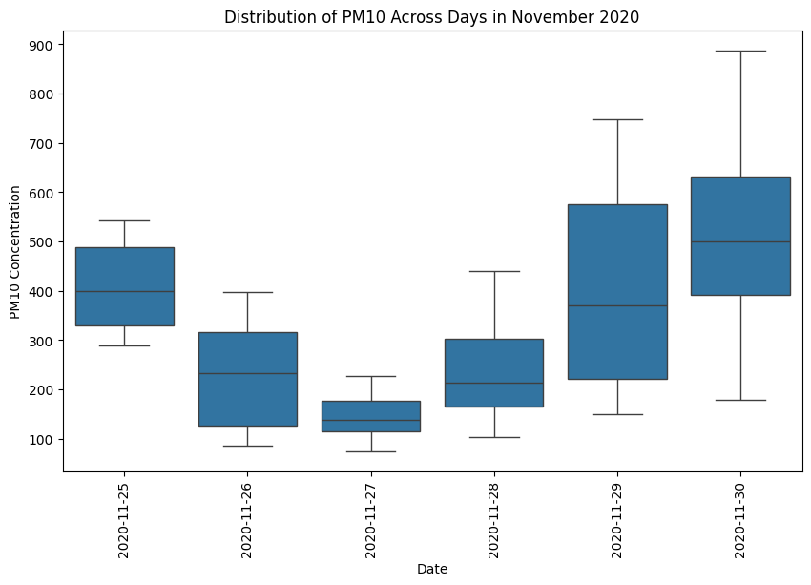
Box plot : PM10 distribution

Slide 22
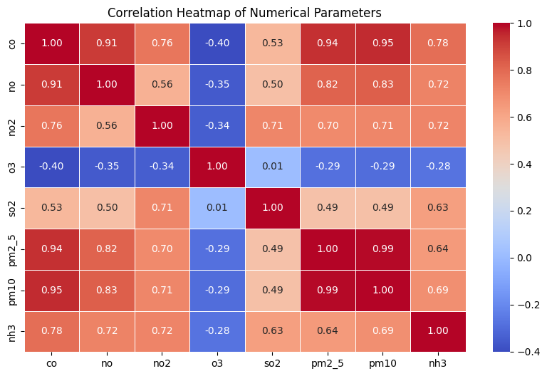
Correlation Heatmap of all the parameters

Slide 23

Module 2
Model training

Slide 24
Module - 2
Designing and training the model step by step
Loading the Data: The dataset is loaded into a Pandas DataFrame.
Feature and Target Selection: Each feature is treated as both input and output for prediction.
Scaling: All features are scaled to a uniform range.
Data Preparation: Sequences are created for time-series forecasting.
Train-Test Split: Data is split into training and testing sets.
Model Definition: A GRU model is designed for sequential prediction.
Model Training: The model is trained using the training data.
Prediction: The model predicts future values for each feature.
Inverse Scaling: Predictions are transformed back to their original scale.
Evaluation: The model’s performance is evaluated using error metrics.
Visualization: Results are visualized for comparison between actual and predicted values.

Slide 25

Model Design
Comparison between different models

Slide 26
Gated Recurrent Unit Networks
A type of recurrent neural network
Algorithm Overview:
GRUs are a simplified variant of LSTMs that combine the forget and input gates into a single update gate. They use:
Update Gate: Determines the importance of past information versus new input.
Reset Gate: Decides how much past information to forget.
Strengths:
Fewer parameters than LSTMs, leading to faster training. Performs well on datasets where computational efficiency is critical.

Slide 27
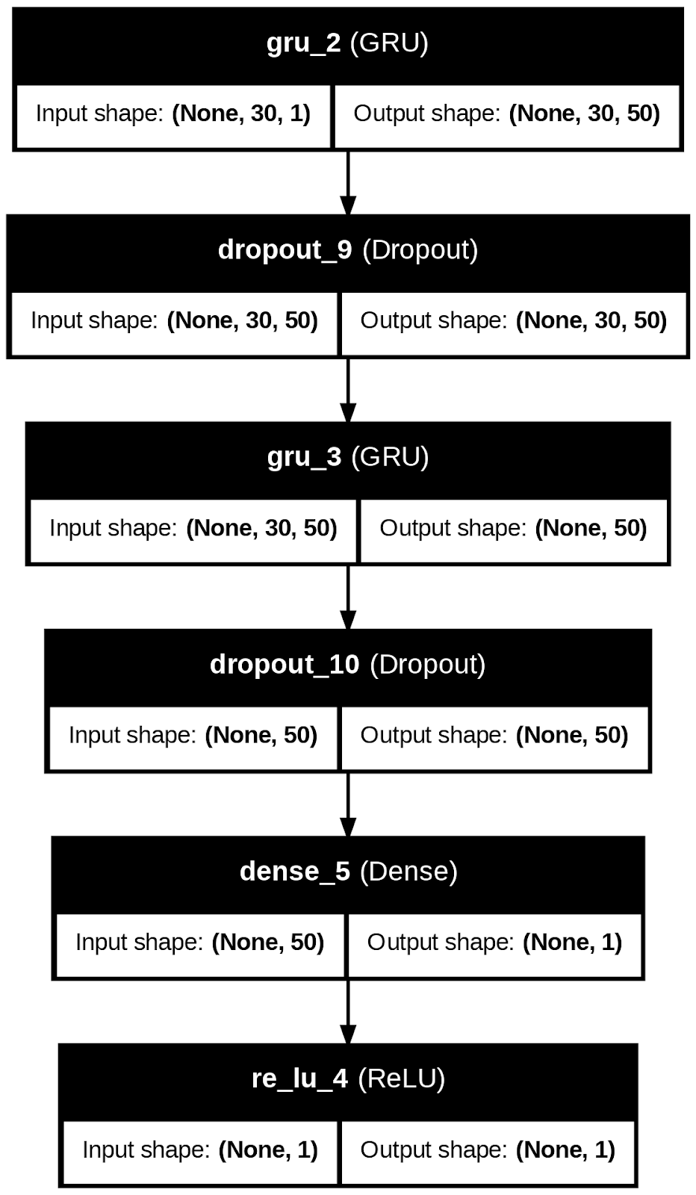

Slide 28
Long short term memory networks
A type of Recurrent neural network
Algorithm Overview:
LSTMs are a type of Recurrent Neural Network (RNN) designed to capture long-term dependencies in sequential data. They utilize special components called memory cells, which have three gates:
Forget Gate: Decides what information to discard from the cell state.
Input Gate: Updates the cell state with new information.
Output Gate: Determines what part of the cell state to output.
Strengths:
Excellent for handling long-term dependencies in time-series data. Effective for data with temporal relationships like air quality predictions.

Slide 29
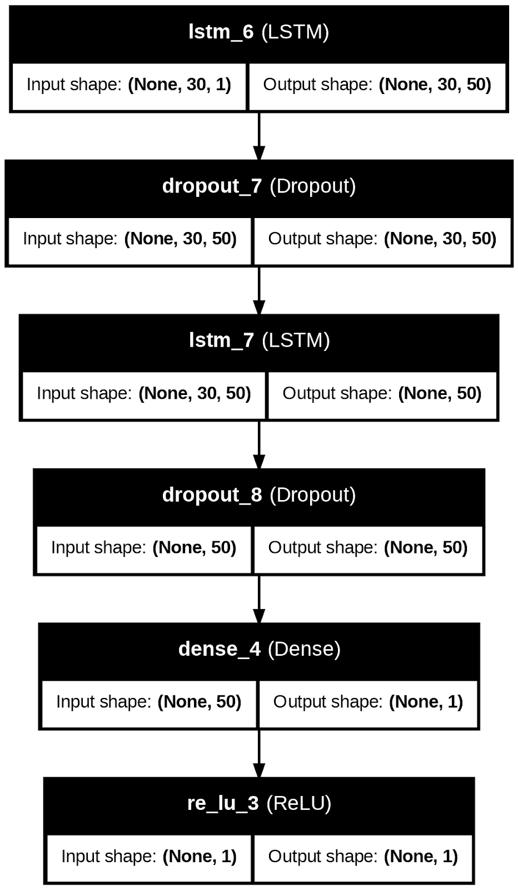

Slide 30
Liquid neural networks
A dynamic and fluid approach
Algorithm Overview:
LNNs adapt their structure dynamically based on the complexity of the input patterns.
They use continuous-time dynamics and neural ODEs (ordinary differential equations) to handle varying temporal patterns efficiently.
Strengths:
Flexible and robust in handling real-time data. Effective for non-stationary, complex sequences like air quality metrics.

Slide 31

Hardware
Implementation

Slide 32
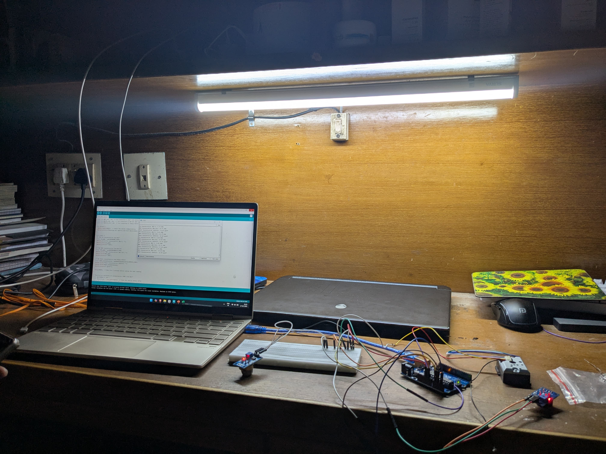

Slide 33
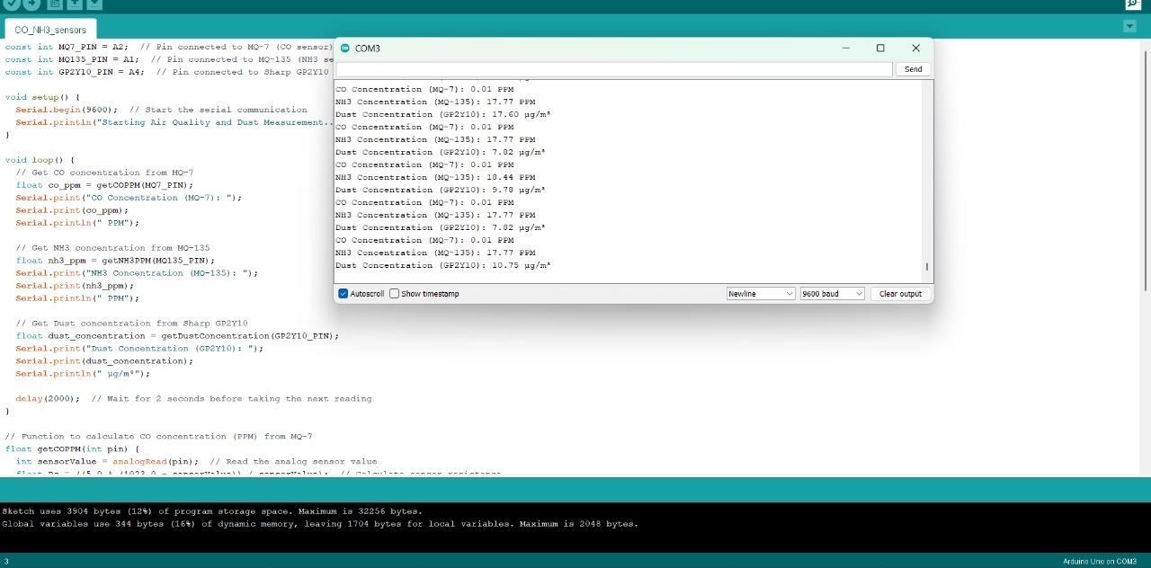

Slide 34

preliminary outputs
performances of each model

Slide 35
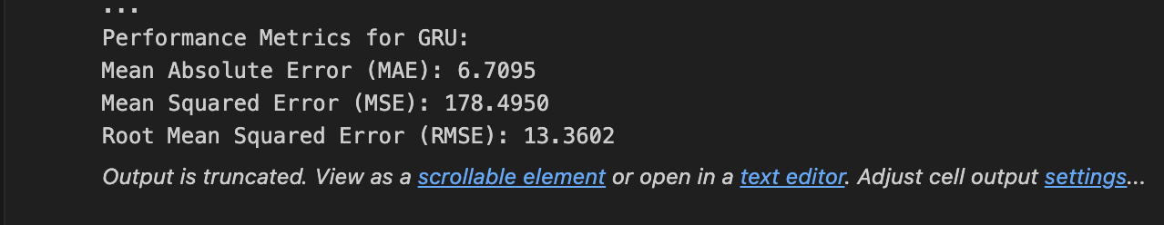
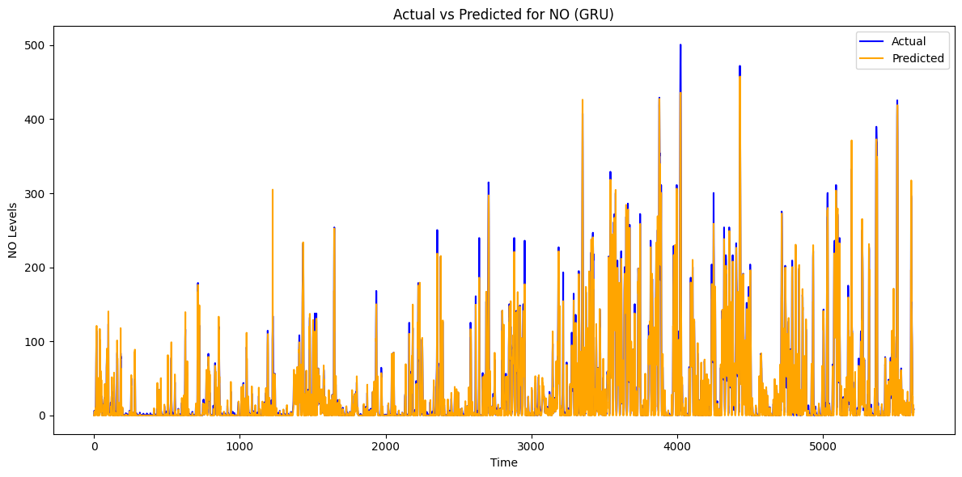
Gated
Recurrent
Unit
Network

Slide 36
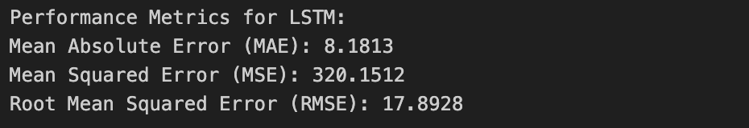
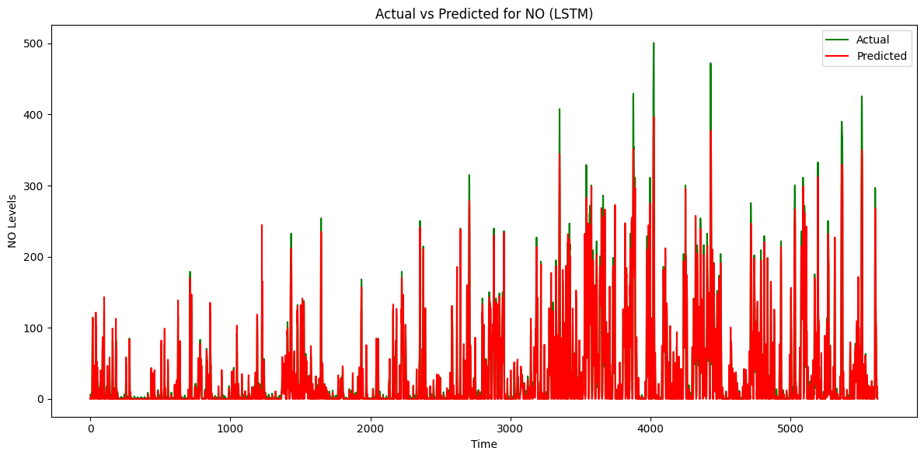
Long
Short
Term
Memory
Network

Slide 37
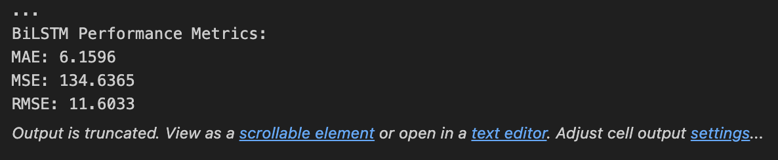
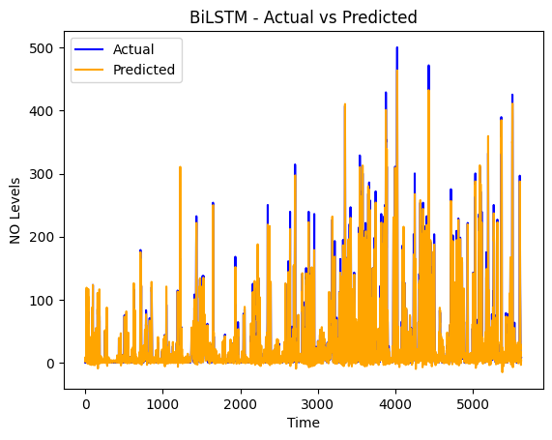
Bi-
Directional
LSTM
network

Slide 38
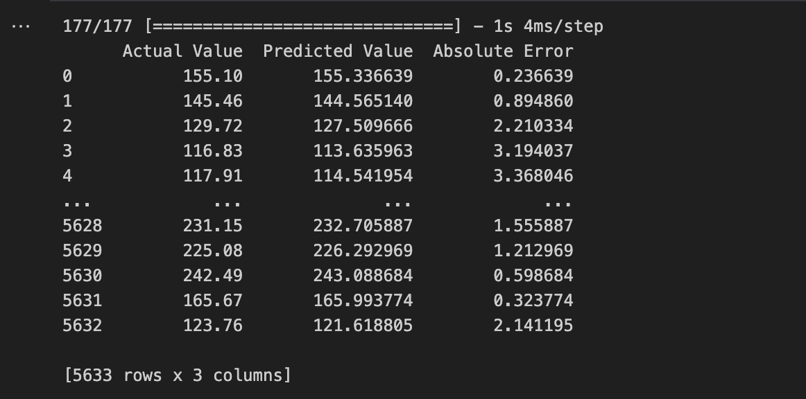
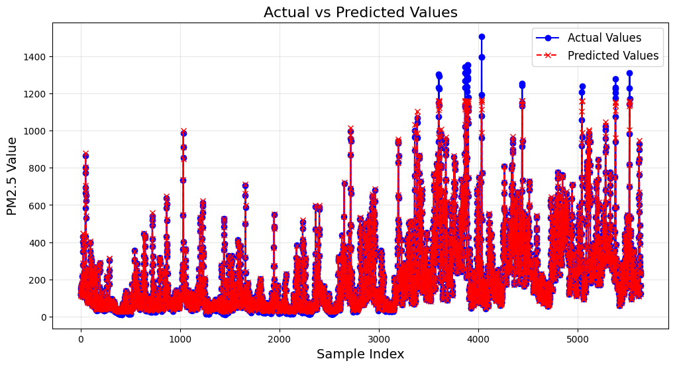
LTCN
(Liquid time
Constant)
Network

Slide 39
References
1. S. Sonawani, K. Patil, and P. Chumchu, "NO2 pollutant concentration forecasting for air quality monitoring by using an optimized deep learning bidirectional GRU model," *International Journal of Computational Science and Engineering*, vol. 23, no. 1, pp. 64–73, Mar. 2021. doi: [10.1504/IJCSE.2021.113652](https://doi.org/10.1504/IJCSE.2021.113652).
2. Q. Tao, F. Liu, Y. Li, and D. Sidorov, "Air Pollution Forecasting Using a Deep Learning Model Based on 1D Convnets and Bidirectional GRU," *IEEE Access*, vol. 7, pp. 76690–76698, 2019. doi: [10.1109/ACCESS.2019.2921578](https://doi.org/10.1109/ACCESS.2019.2921578).
3. J. Wang, X. Li, T. Wang, J. Li, and Q. Sun, "A CA-GRU-based model for air quality prediction," *International Journal of Adaptive and Innovative Systems*, vol. 7, no. 3, pp. 184–198, Nov. 2021. doi: [10.1504/IJAHUC.2021.119098](https://doi.org/10.1504/IJAHUC.2021.119098).
4. X. Wang, J. Yan, X. Wang, and Y. Wang, "Air Quality Forecasting Using the GRU Model Based on Multiple Sensors Nodes," *IEEE Sensors Letters*, vol. 7, no. 7, Art. no. 6003804, Jul. 2023. doi: [10.1109/LSENS.2023.3290144](https://doi.org/10.1109/LSENS.2023.3290144).
5. B. Liu, Z. Qi, and L. Gao, "Enhanced Air Quality Prediction through Spatio-temporal Feature Extraction and Fusion: A Self-tuning Hybrid Approach with GCN and GRU," *Water Air Soil Pollution*, vol. 235, no. 532, 2024. doi: [10.1007/s11270-024-07346-4](https://doi.org/10.1007/s11270-024-07346-4).
6. W. Chang, X. Chen, Z. He, and S. Zhou, "A Prediction Hybrid Framework for Air Quality Integrated with W-BiLSTM(PSO)-GRU and XGBoost Methods," *Sustainability*, vol. 15, no. 22, Art. no. 16064, 2023. doi: [10.3390/su152216064](https://doi.org/10.3390/su152216064).

Slide 40
References
7. X. Wang and Y. Zhang, "Multi-Step-Ahead Time Series Prediction Method with Stacking LSTM Neural Network," in *Proc. 3rd Int. Conf. Artif. Intell. Big Data (ICAIBD)*, Chengdu, China, 2020, pp. 51–55. doi: [10.1109/ICAIBD49809.2020.9137492](https://doi.org/10.1109/ICAIBD49809.2020.9137492).
8. W. Zhang, W. Shen, and X. Lin, "A Short-Term Traffic Flow Prediction Method of Improved PSO-LSTM," in *Proc. 3rd Int. Conf. Intell. Commun. Comput. (ICC)*, Nanchang, China, 2023, pp. 394–399. doi: [10.1109/ICC59986.2023.10421500](https://doi.org/10.1109/ICC59986.2023.10421500).
9. T. Iha, I. Kawamitsu, A. Ohshiro, and M. Nakamura, "An LSTM-based Multivariate Time Series Predicting Method for Number of Restaurant Customers in Tourism Resorts," in *Proc. 36th Int. Tech. Conf. Circuits/Systems, Comput. Commun. (ITC-CSCC)*, Jeju, Korea (South), 2021, pp. 1–4. doi: [10.1109/ITC-CSCC52171.2021.9501432](https://doi.org/10.1109/ITC-CSCC52171.2021.9501432).
10. I. Amalou, N. Mouhni, and A. Abdali, "CNN-LSTM architectures for non-stationary time series: decomposition approach," in *Proc. Int. Conf. Global Aeronaut. Eng. Satellite Technol. (GAST)*, Marrakesh, Morocco, 2024, pp. 1–5. doi: [10.1109/GAST60528.2024.10520774](https://doi.org/10.1109/GAST60528.2024.10520774).
11. S. Saha, F. Bovolo, and L. Bruzzone, "Change Detection in Image Time-Series Using Unsupervised LSTM," *IEEE Geosci. Remote Sens. Lett.*, vol. 19, Art. no. 8005205, 2022. doi: [10.1109/LGRS.2020.3043822](https://doi.org/10.1109/LGRS.2020.3043822).
12. M. Masum, H. Shahriar, H. M. Haddad, and M. S. Alam, "r-LSTM: Time Series Forecasting for COVID-19 Confirmed Cases with LSTM-based Framework," in *Proc. IEEE Int. Conf. Big Data*, Atlanta, GA, USA, 2020, pp. 1374–1379. doi: [10.1109/BigData50022.2020.9378276](https://doi.org/10.1109/BigData50022.2020.9378276).

Slide 41
References
13. K. Kumar, A. Verma, N. Gupta, and A. Yadav, "Liquid Neural Networks: A Novel Approach to Dynamic Information Processing," in *Proc. Int. Conf. Adv. Computation, Commun. Inf. Technol. (ICAICCIT)*, Faridabad, India, 2023, pp. 725–730. doi: [10.1109/ICAICCIT60255.2023.10466162](https://doi.org/10.1109/ICAICCIT60255.2023.10466162).
14. C. Li, Y. Li, and Y. Bao, "Research on Air Quality Prediction Based on Machine Learning," in *Proc. 2nd Int. Conf. Intell. Comput. Human-Computer Interaction (ICHCI)*, Shenyang, China, 2021, pp. 77–81. doi: [10.1109/ICHCI54629.2021.00022](https://doi.org/10.1109/ICHCI54629.2021.00022).
15. D. Iskandaryan, F. Ramos, and S. Trilles, "Graph Neural Network for Air Quality Prediction: A Case Study in Madrid," *IEEE Access*, vol. 11, pp. 2729–2742, 2023. doi: [10.1109/ACCESS.2023.3234214](https://doi.org/10.1109/ACCESS.2023.3234214).
16. P. Chaturvedi, "Air Quality Prediction System Using Machine Learning Models," *Water Air Soil Pollution*, vol. 235, no. 578, 2024. doi: [10.1007/s11270-024-07390-0](https://doi.org/10.1007/s11270-024-07390-0).
17. S. Ban, B. Wei, W. Xie, Y. Xu, and C. Jiang, "Prediction of Air Quality in Nanjing Based on Recurrent Neural Network," in *Proc. 29th Int. Conf. Geoinformatics*, Beijing, China, 2022, pp. 1–6. doi: [10.1109/Geoinformatics57846.2022.9963824](https://doi.org/10.1109/Geoinformatics57846.2022.9963824).
18. S. Gupta, A. Moledina, S. Athavale, S. Gajare, and M. Kate, "Air Quality Prediction Using Machine Learning: A Comparative Study," in *Proc. 6th Int. Conf. Adv. Sci. Technol. (ICAST)*, Mumbai, India, 2023, pp. 485–489. doi: [10.1109/ICAST59062.2023.10454930](https://doi.org/10.1109/ICAST59062.2023.10454930).

